Slide 1
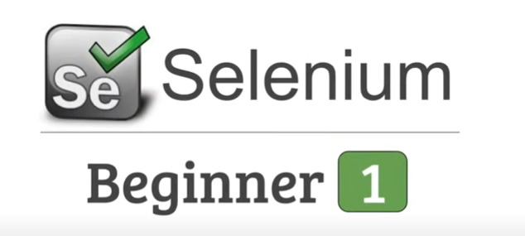

Slide 2
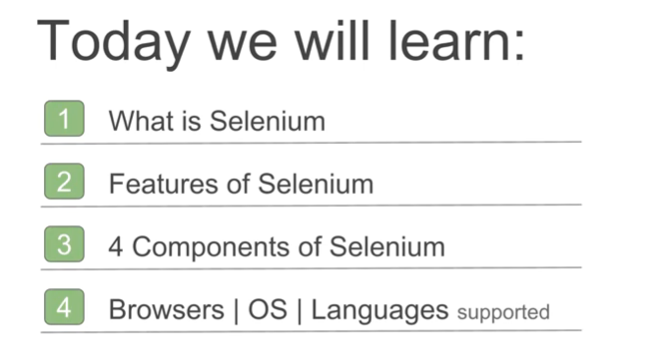

Slide 3
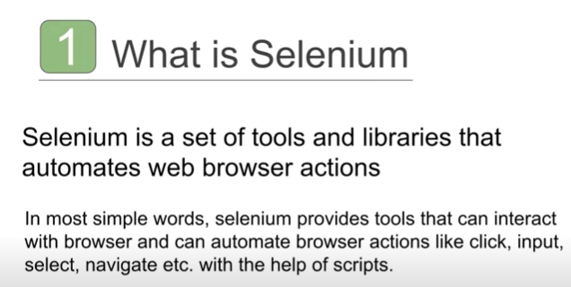

Slide 4
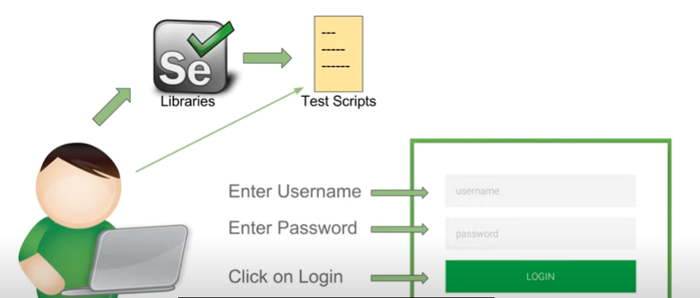
You want to test a login page so you will enter the username, password and click on the login button.
If you want to automate this testing, you will download the selenium libraries in any of your preferred programming languages.
And using these libraries you will create your test script and the next time you want to test this login page, you will call this script.

Slide 5
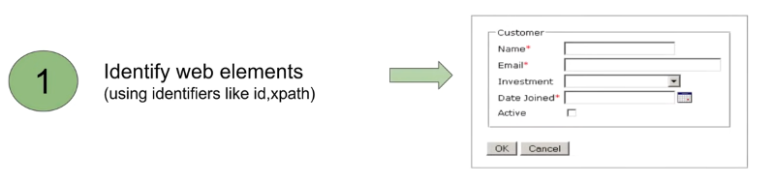
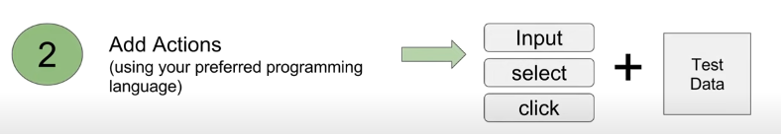

The first thing you will identify the web elements like text boxes, dropdowns and buttons on the web page where you want to work and then you will add the actions in your preferred programming language along with the test data and then you will run your test script and validate

Slide 6
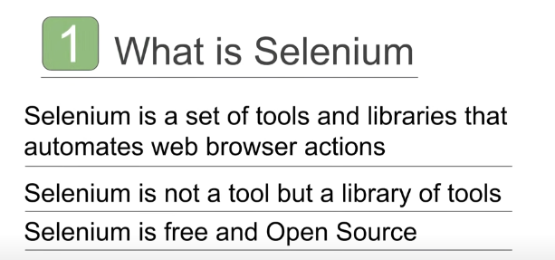


Slide 7
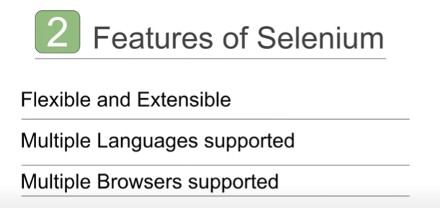

Slide 8
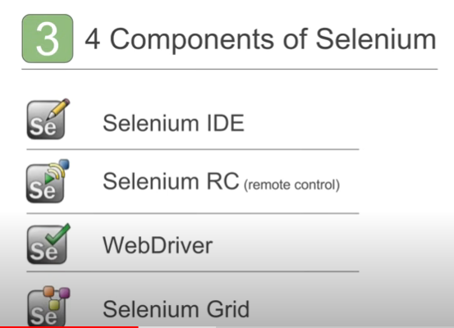

Slide 9
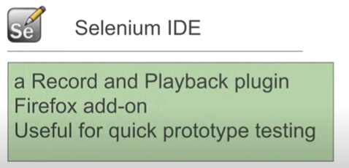
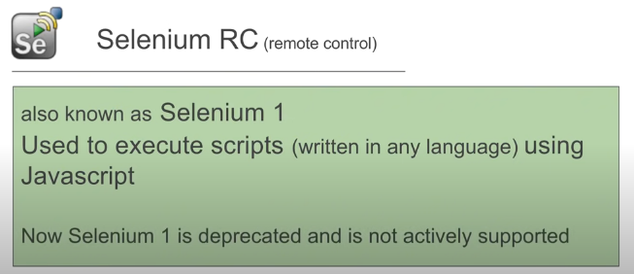

Slide 10
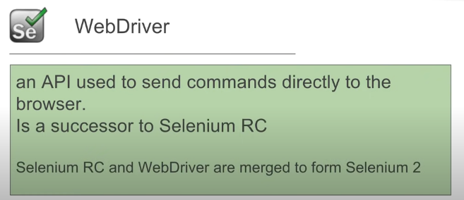
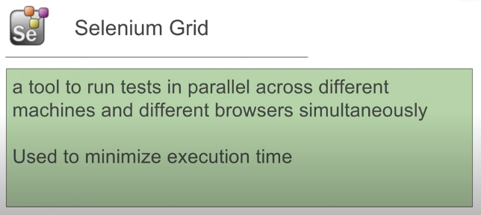

Slide 11

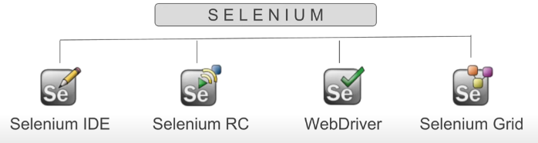




2004
Shinya Kasatani
Paul Hammant
Simon Stewart
Patrick Lightbody

Slide 12
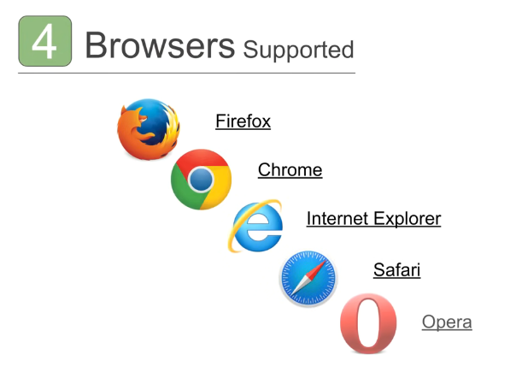

Slide 13
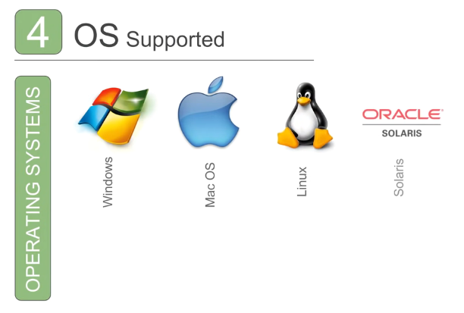

Slide 14


Slide 15
